Slide 1

A Review
On
Deepfake Videos Detection Using DeepLearning
Bachelor Of Technology
In
Computer Science & Engineering
By
A Sai Shivani : 21N31A0510
B Pavan Kuma : 21N31A0534
Abdul Rahman : 21N31A0501
Under the Esteemed Guidance of
Dr.S.Shanthi
Professor,HOD
Dept. of CSE

Slide 2
Abstract
Deepfake videos have emerged as a critical challenge in the digital age, with their ability to manipulate and fabricate video content convincingly. These videos pose significant threats to privacy, security, and the dissemination of truthful information. Real-time detection of Deepfake videos is essential for mitigating their misuse, especially in applications requiring immediate responses, such as social media platforms, video conferencing, and live broadcasts. This project focuses on the development of a real-time Deepfake video detection framework utilizing deep learning techniques, specifically convolutional neural networks (CNNs) and Generative Convolutional Vision Transformer (GenConViT) ,LSTM and RESNET.
.

Slide 3
INTRODUCTION
Deepfake videos, created using advanced AI techniques, pose a significant threat by enabling the spread of misinformation, identity fraud, and manipulated media. These videos leverage deep learning models such as Generative Adversarial Networks (GANs) to create hyper-realistic synthetic videos, making their detection increasingly challenging. GenConViT is a hybrid model that combines the strengths of convolutional neural networks (CNNs) and vision transformers (ViTs) to improve the detection of deepfake videos.
Why GenConViT for Deepfake Detection?
Feature Extraction Efficiency
Improved Generalization:
Attention Mechanisms
Robust Against Adversarial Attacks

Slide 4
PURPOSE AND OBJECTIVES
The primary purpose of deepfake video detection using GenConViT is to identify and prevent the misuse of synthetic videos generated using AI. Deepfakes pose serious ethical, security, and privacy threats, and detecting them is crucial to maintaining the integrity of digital media.
Enhancing Detection Accuracy
Generalizing Across Different Deepfake Techniques
Strengthening Security and Preventing Misinformation
The main objective of deepfake video detection using GenConViT is to develop a robust, efficient, and generalizable model that can accurately distinguish between real and manipulated videos. This is crucial to prevent misinformation, enhance security, and maintain digital media integrity.

Slide 5
SCOPE OF PROJECT
Research and Development
Media Security and Digital Trust
Law Enforcement and Digital Forensics
Social Media and Content Moderation
Ethical AI and Policy Regulation
Cybersecurity and Fraud Prevention
Biometric Security and Authentication

Slide 6
EXISTING PROJECTS
1.GOTCHA
Focusing on real-time deepfake detection, GOTCHA employs a challenge-respons
mechanism to establish authenticity during live video interactions. By presenting
specific challenges that exploit limitations of deepfake generation pipelines, this
approach effectively degrades the quality of deepfakes, facilitating their detection.
2.GRACE (Graph-Regularized Attentive Convolutional Entanglement):
GRACE introduces a novel approach for robust deepfake video detection by
constructing a graph with sparse constraints to entangle spatial and temporal features.
This method enhances stability and performance, particularly in noisy face sequences.
3.Detect Fakes:
A research initiative by the MIT Media Lab, Detect Fakes aims to identify AI-
generated misinformation. The project focuses on uncovering subtle indicators of
algorithmic manipulation in videos, enhancing the ability to detect deepfakes.

Slide 7
PROPOSED SYSTEM
Deepfake Video Detection Using Generative Convolutional Vision Transformer: This project, developed by researchers Deressa Wodajo, Solomon Atnafu, and Zahid Akhtar, introduces the GenConViT model. The model combines CNN and Vision Transformer architectures for feature extraction and employs Autoencoder and Variational Autoencoder techniques to analyze latent data distributions. It has been evaluated on datasets such as DeepfakeTIMIT, achieving an average accuracy of 95.2%

Slide 8
HARDWARE AND SOFTWARE REQUIREMENTS
HARDWARE REQUIREMENTS:
Processor : i5(2nd generation or later)
Ram : 4GB or above.
Hard disk : 10GB or above.
SOFTWARE REQUIREMENTS:
Technology/Language : Python version 3.7.2
Operating System : Windows
IDE : VScode

Slide 9
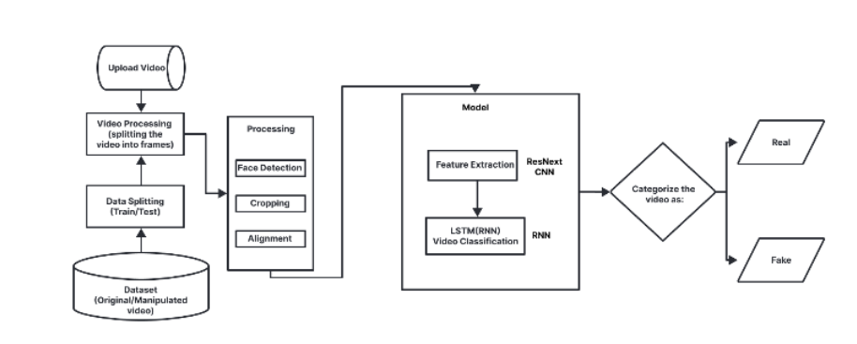
SYSTEM ARCHITECTURE

Slide 10
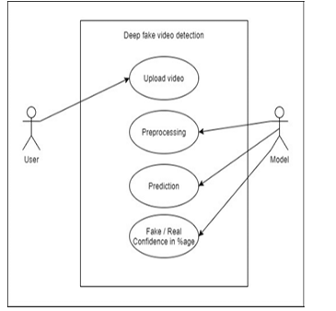
USE CASE DIAGRAM

Slide 11
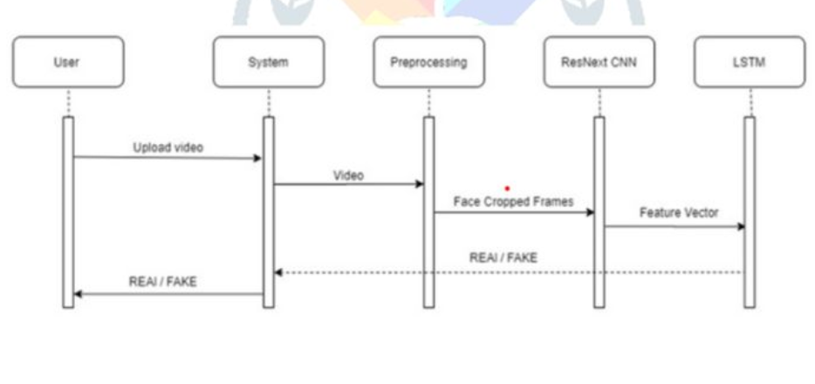
SEQUENCE DIAGRAM
CNN
GenConViT

Slide 12
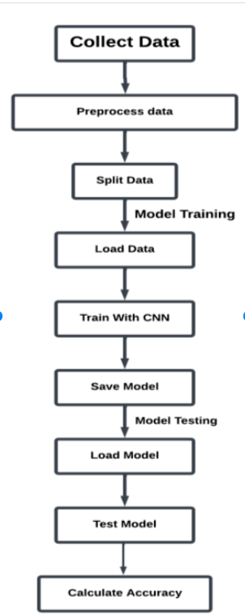
DATA FLOW DIAGRAM

Slide 13
MODULES
A Deepfake Video Detection System consists of multiple interconnected modules that work together to analyze videos, extract features, and classify them as real or fake. Below are the essential modules required for an effective system
Video Upload Module
Video Preprocessing Module
Face Detection & Alignment Module
Feature Extraction Module
Deepfake Detection & Classification Module
User Interface (UI) Module

Slide 14
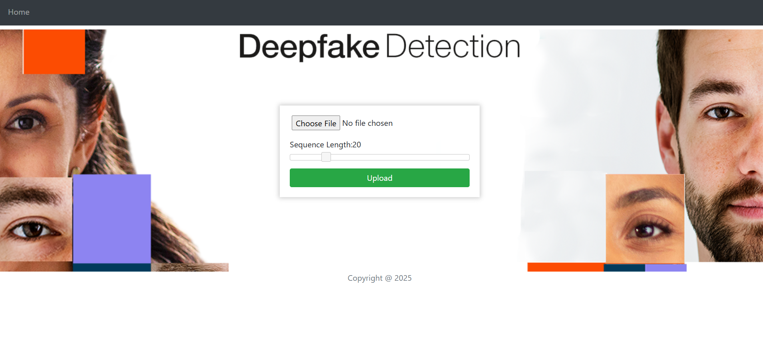
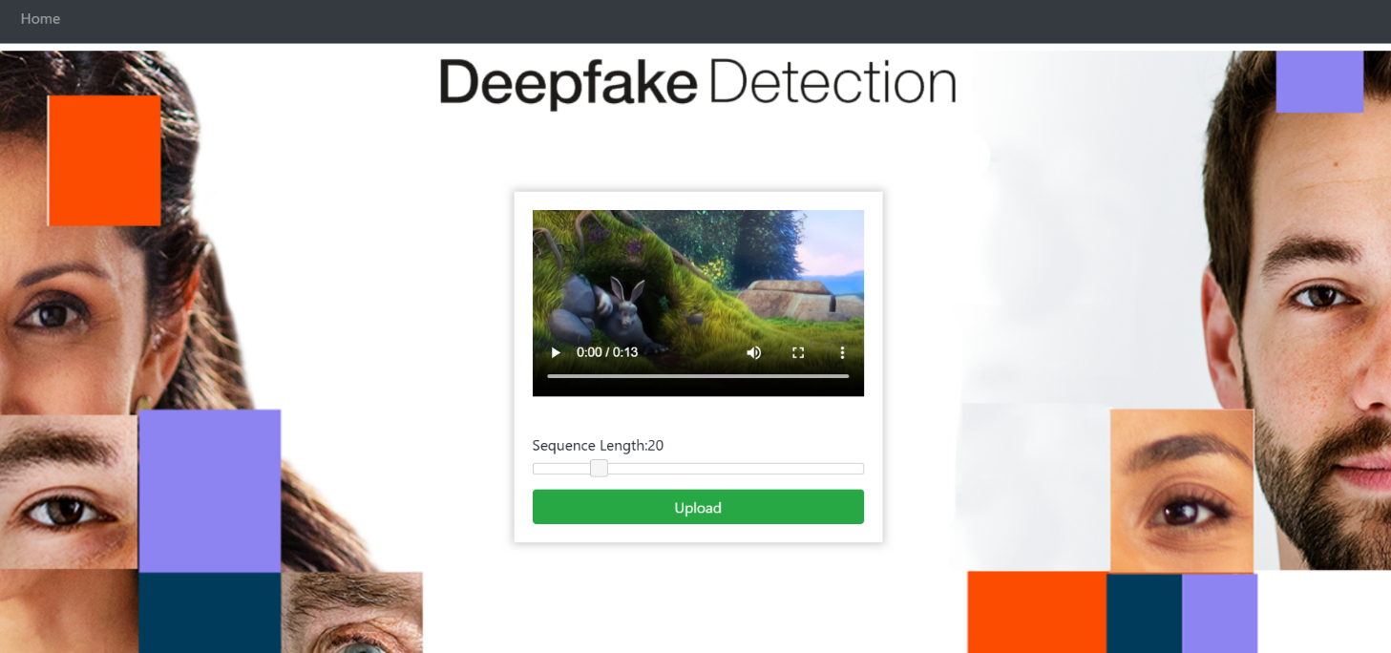
OUTPUT SCREENS

Slide 15
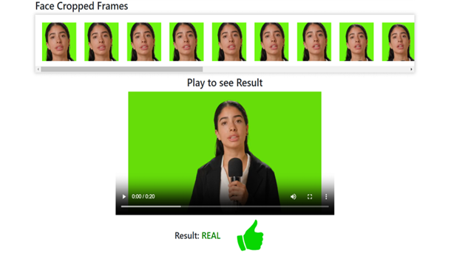
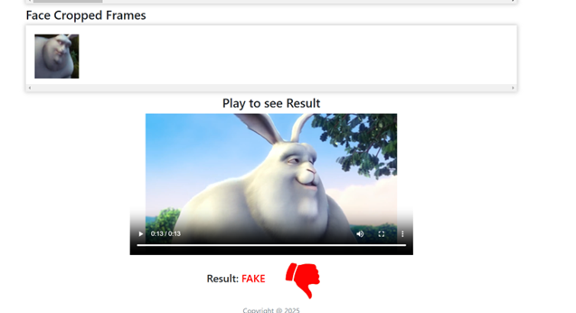

Slide 16
CONCULSION
The Deepfake Video Detection project successfully implements an advanced deep learning-based approach to identify manipulated videos with high accuracy. By leveraging CNN, ResNet, LSTM, and Vision Transformer (GenConViT) architectures, the system efficiently extracts spatial and temporal features to detect deepfakes. The combination of frame-based analysis, face detection, and classification models ensures reliable and automated detection. The project's effectiveness is further enhanced by robust preprocessing techniques and dataset management. The results demonstrate a high detection accuracy, making this system a valuable tool for combating misinformation, ensuring media authenticity, and strengthening digital security. Future improvements may focus on enhancing real-time detection, expanding datasets, and optimizing computational efficiency for large-scale deployment.

Slide 17
THANK YOU

